Slide 1

Event
Management
Portal
Presented By:-
Shivam Anand Bhushan

Slide 2
Content
Introduction
Objectives
Features
Tools and technologies
System Architecture
Database Schema
API Endpoints
Demo Flow
Conclusion
Event Management Portal
March - 2025
‹#›

Slide 3

1. Overview
Event Management Portal
The Event Management Platform is a comprehensive web application designed to facilitate event management for organizers and attendees. The platform allows users to create events, manage bookings, and process payments. The system supports authentication using Spring Security with JWT, and data management using JPA with a PostgreSQL database.
Event Management Portal
Title of project
March - 2025
‹#›
Month - Year
‹#›

Slide 4
2. Objectives
Event Management Portal
Provide an easy-to-use platform for event management.
Enable a seamless booking experience for attendees.
Ensure secure online payments through Razorpay.
Automatically close bookings once seats are full.
Update slot availability when booking cancellations occur.
Event Management Portal
Title of project
March - 2025
‹#›
Month - Year
‹#›

Slide 5
3. Features
Event Management Portal
For Organizers: Create, update, and delete events.
For Attendees: Book, cancel, and view events.
Payment Integration: Razorpay for transactions.
Seat Management: Updates available seats.
Event Management Portal
Title of project
March - 2025
‹#›
Month - Year
‹#›

Slide 6

4. Tools & Technologies
Technology Stack –
Frontend: HTML, CSS, Javascript
Backend: Java Springboot
Database: PostgreSQL
Authentication: Spring Security with JWT
Payments: Razorpay payment Integration
Event Management Portal
Title of project
March - 2025
‹#›
Month - Year
‹#›

Slide 7
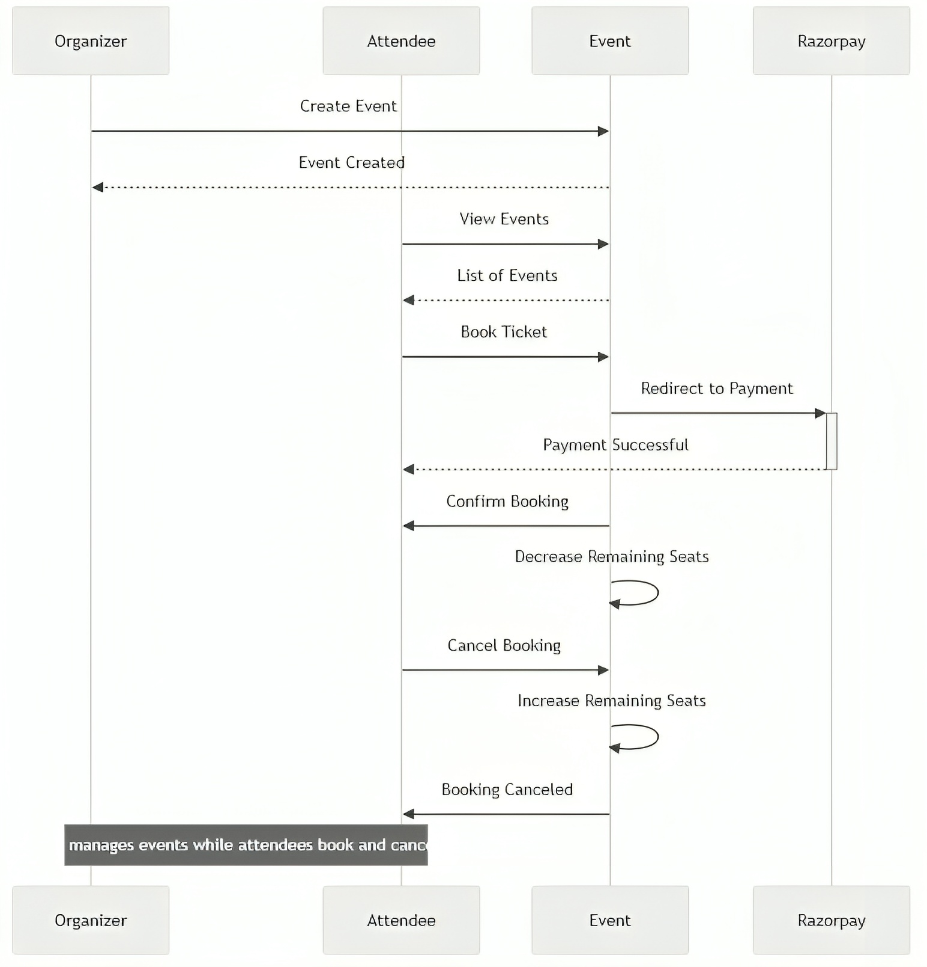
5.1. System Architecture
Sequence Diagram
Event Management Portal
Title of project
March - 2025
‹#›
Month - Year
‹#›

Slide 8
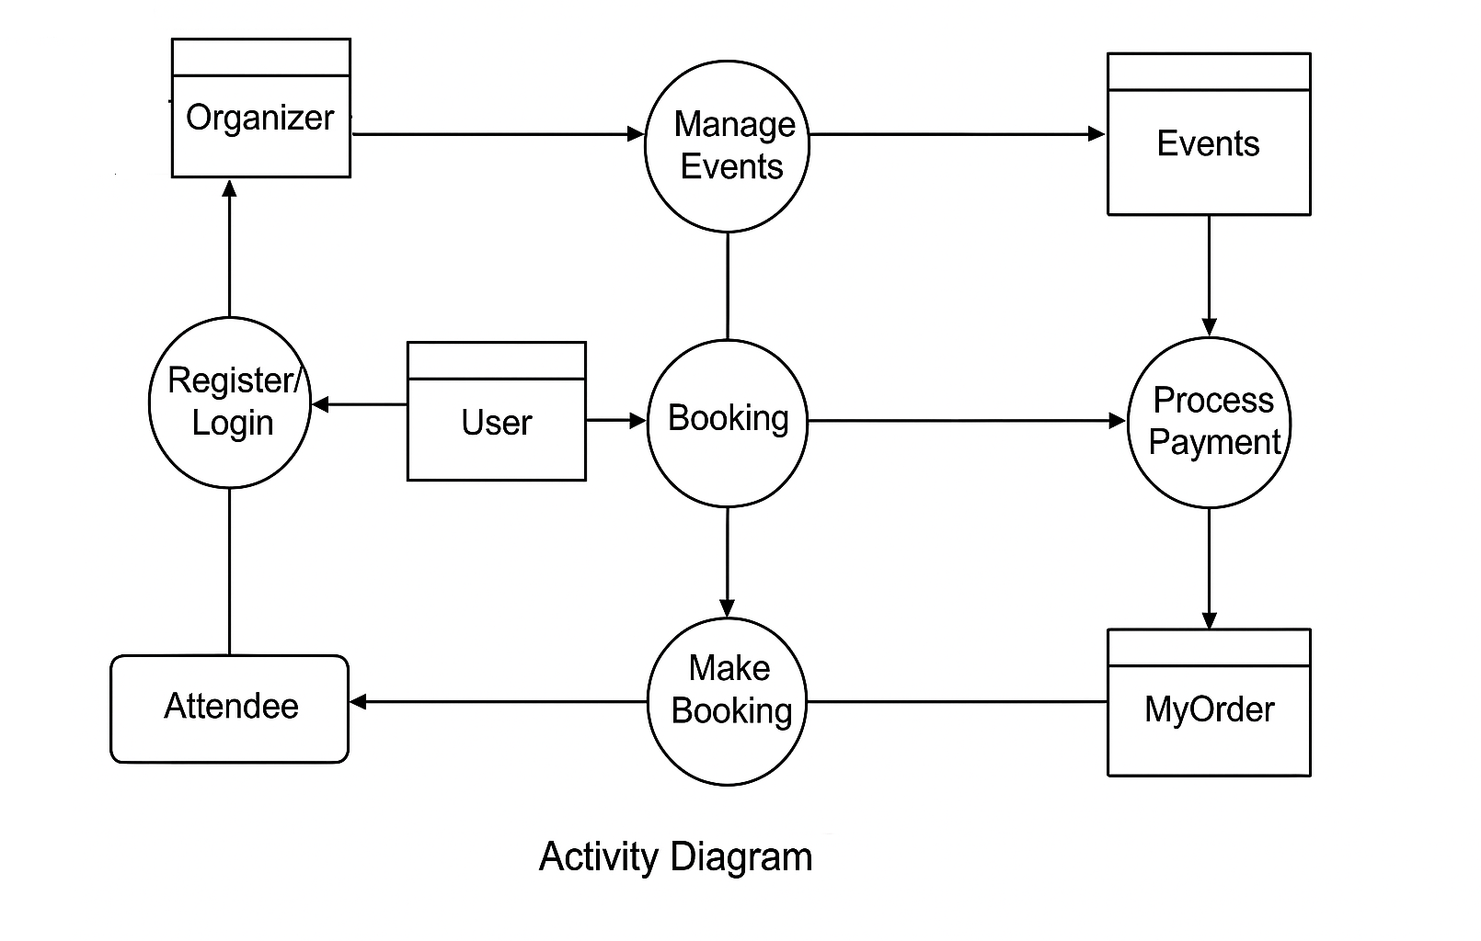
5.2. System Architecture
Activity Diagram
Event Management Portal
Title of project
March - 2025
‹#›
Month - Year
‹#›

Slide 9
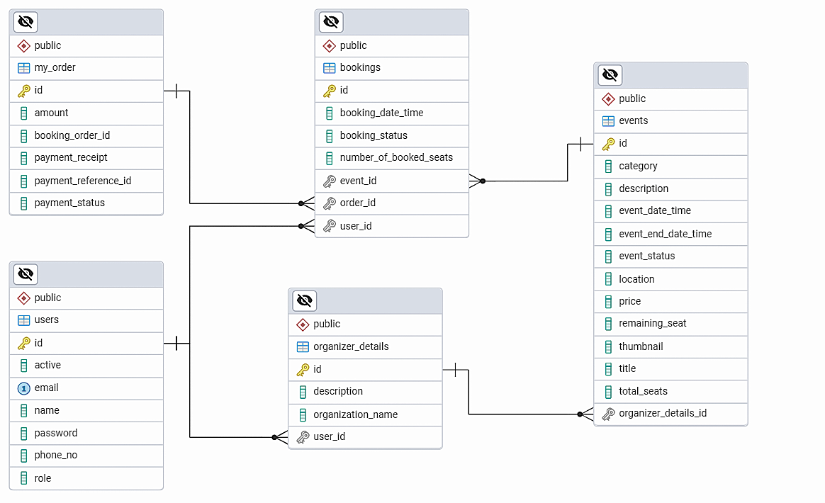
6. Database Schema
Event Management Portal
Title of project
March - 2025
‹#›
Month - Year
‹#›

Slide 10
7.1. API Endpoints
Event Management Portal
Authentication and User Management
POST /user/create-user → Register a new user.
POST /generate-token → To generate token and Login.
Event Management (Organizer)
GET /events/organizer/{userId} → View events created by organizer.
PUT /events/update/{id} → Update event details.
DELETE /events/{id} → Delete an event.
GET /events/{eventId} → Get specific event.
Event Management Portal
Title of project
March - 2025
‹#›
Month - Year
‹#›

Slide 11
7.2. API Endpoints
Event Management Portal
Event Management (Attendee)
GET /events → View all events.
Booking Management (Attendee)
GET /bookings/all/{id} → Get all bookings made by the logged-in user.
POST /bookings/create-booking/{refId} → Book a particular event.
PUT /bookings/cancel/{bookingId} → Cancel a booking.
Payment Management
POST /user/create-order → Initiate payment for an event (create an order).
PUT /update-order → After payment done, status from “created” to “paid”.
Event Management Portal
Title of project
March - 2025
‹#›
Month - Year
‹#›

Slide 12
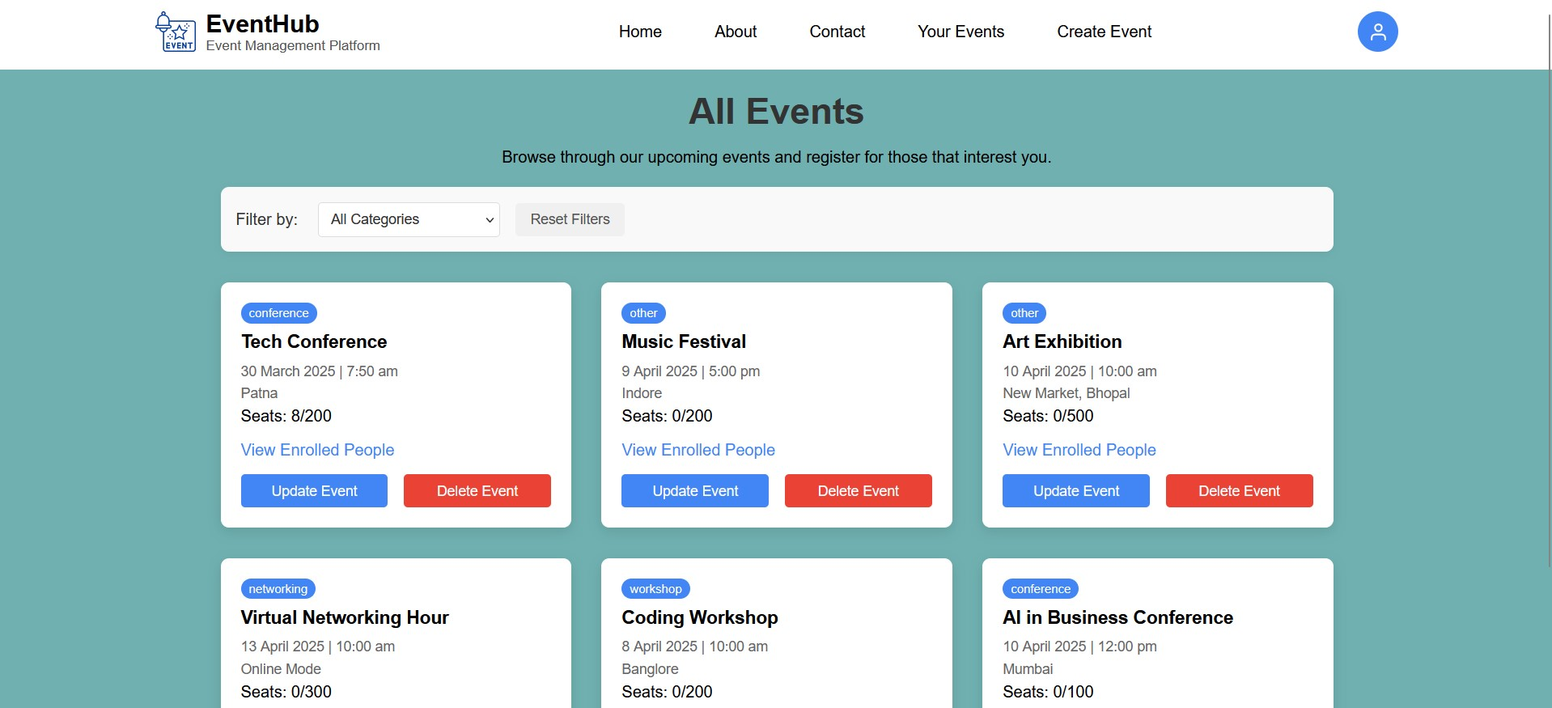
8.1. Demo Flow
Events Managed by the Logged in Organizer (Organizer Dashboard)
Event Management Portal
Title of project
March - 2025
‹#›
Month - Year
‹#›

Slide 13
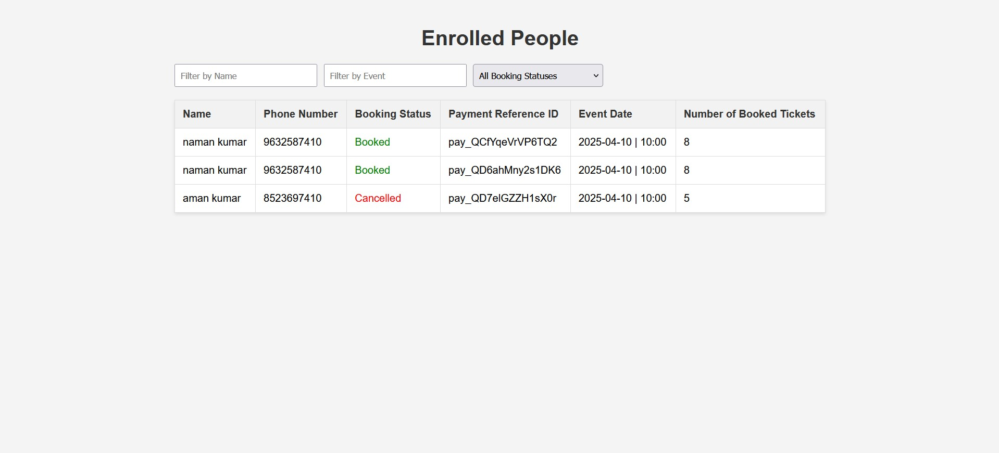
8.2. Demo Flow
Enrolled People for a particular Event (Organizer Dashboard)
Event Management Portal
Title of project
March - 2025
‹#›
Month - Year
‹#›

Slide 14
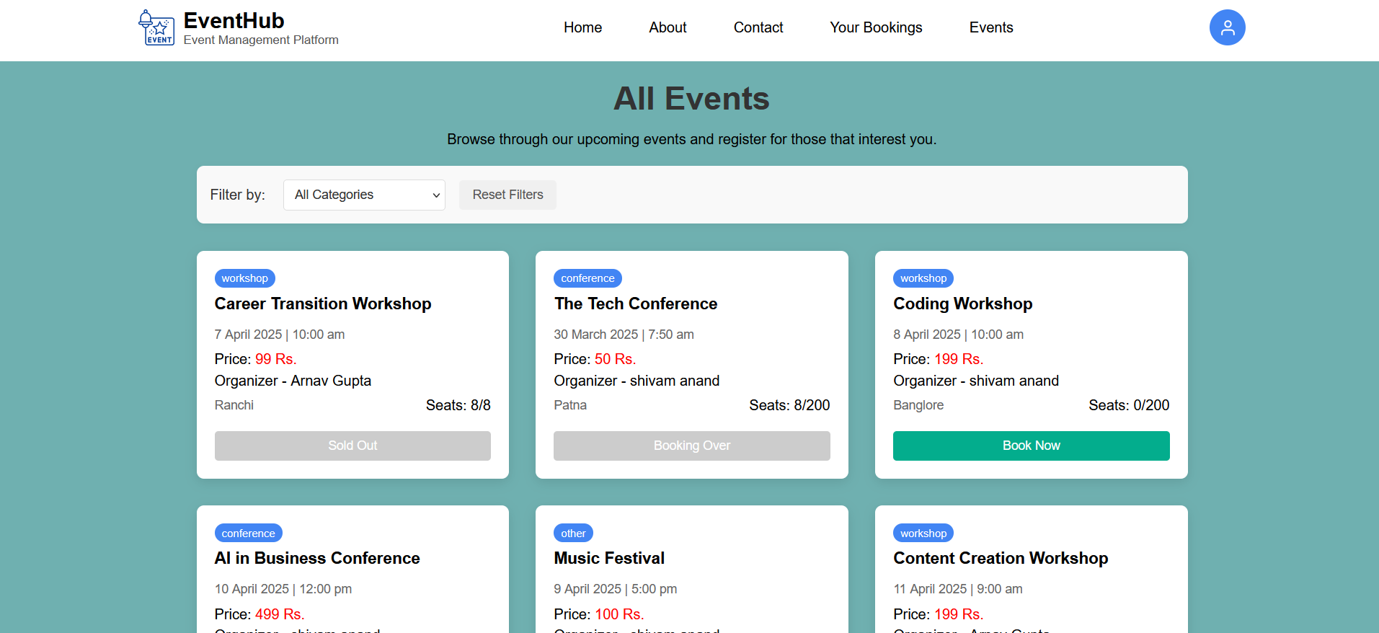
8.3. Demo Flow
Displaying Events Hosted by All Organizers (Attendee Dashboard)
Event Management Portal
Title of project
March - 2025
‹#›
Month - Year
‹#›

Slide 15
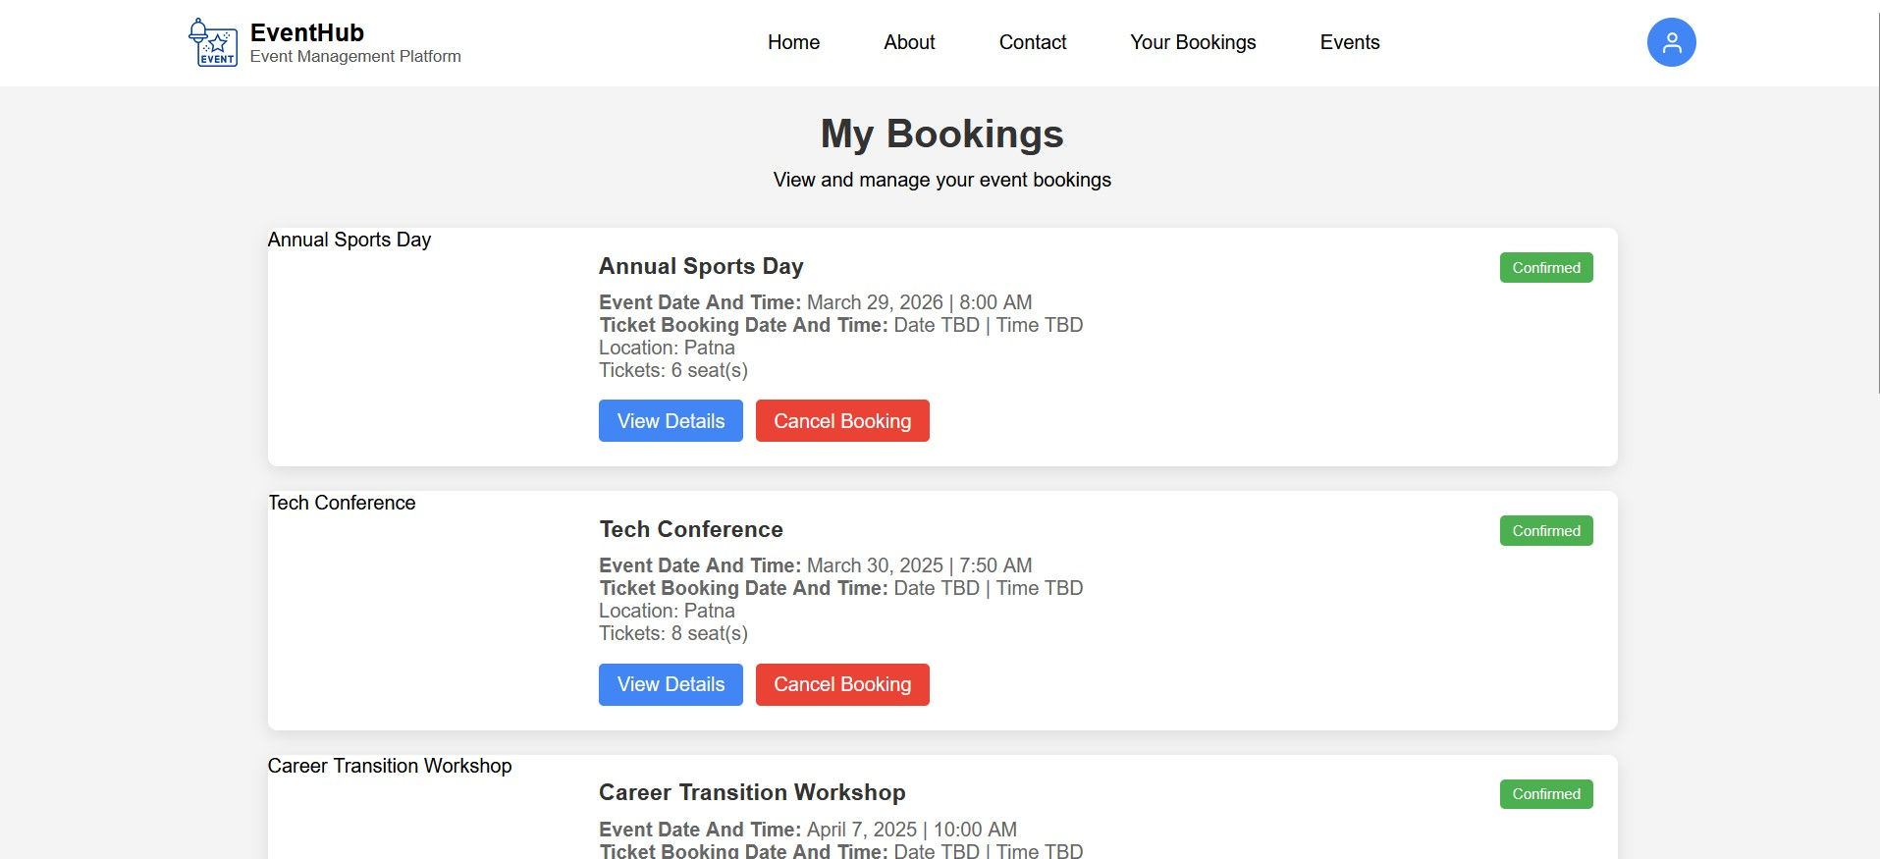
8.4. Demo Flow
Attendee's Booking Overview (Attendee Dashboard)
Event Management Portal
Title of project
March - 2025
‹#›
Month - Year
‹#›

Slide 16
Thank You

